Slide 1
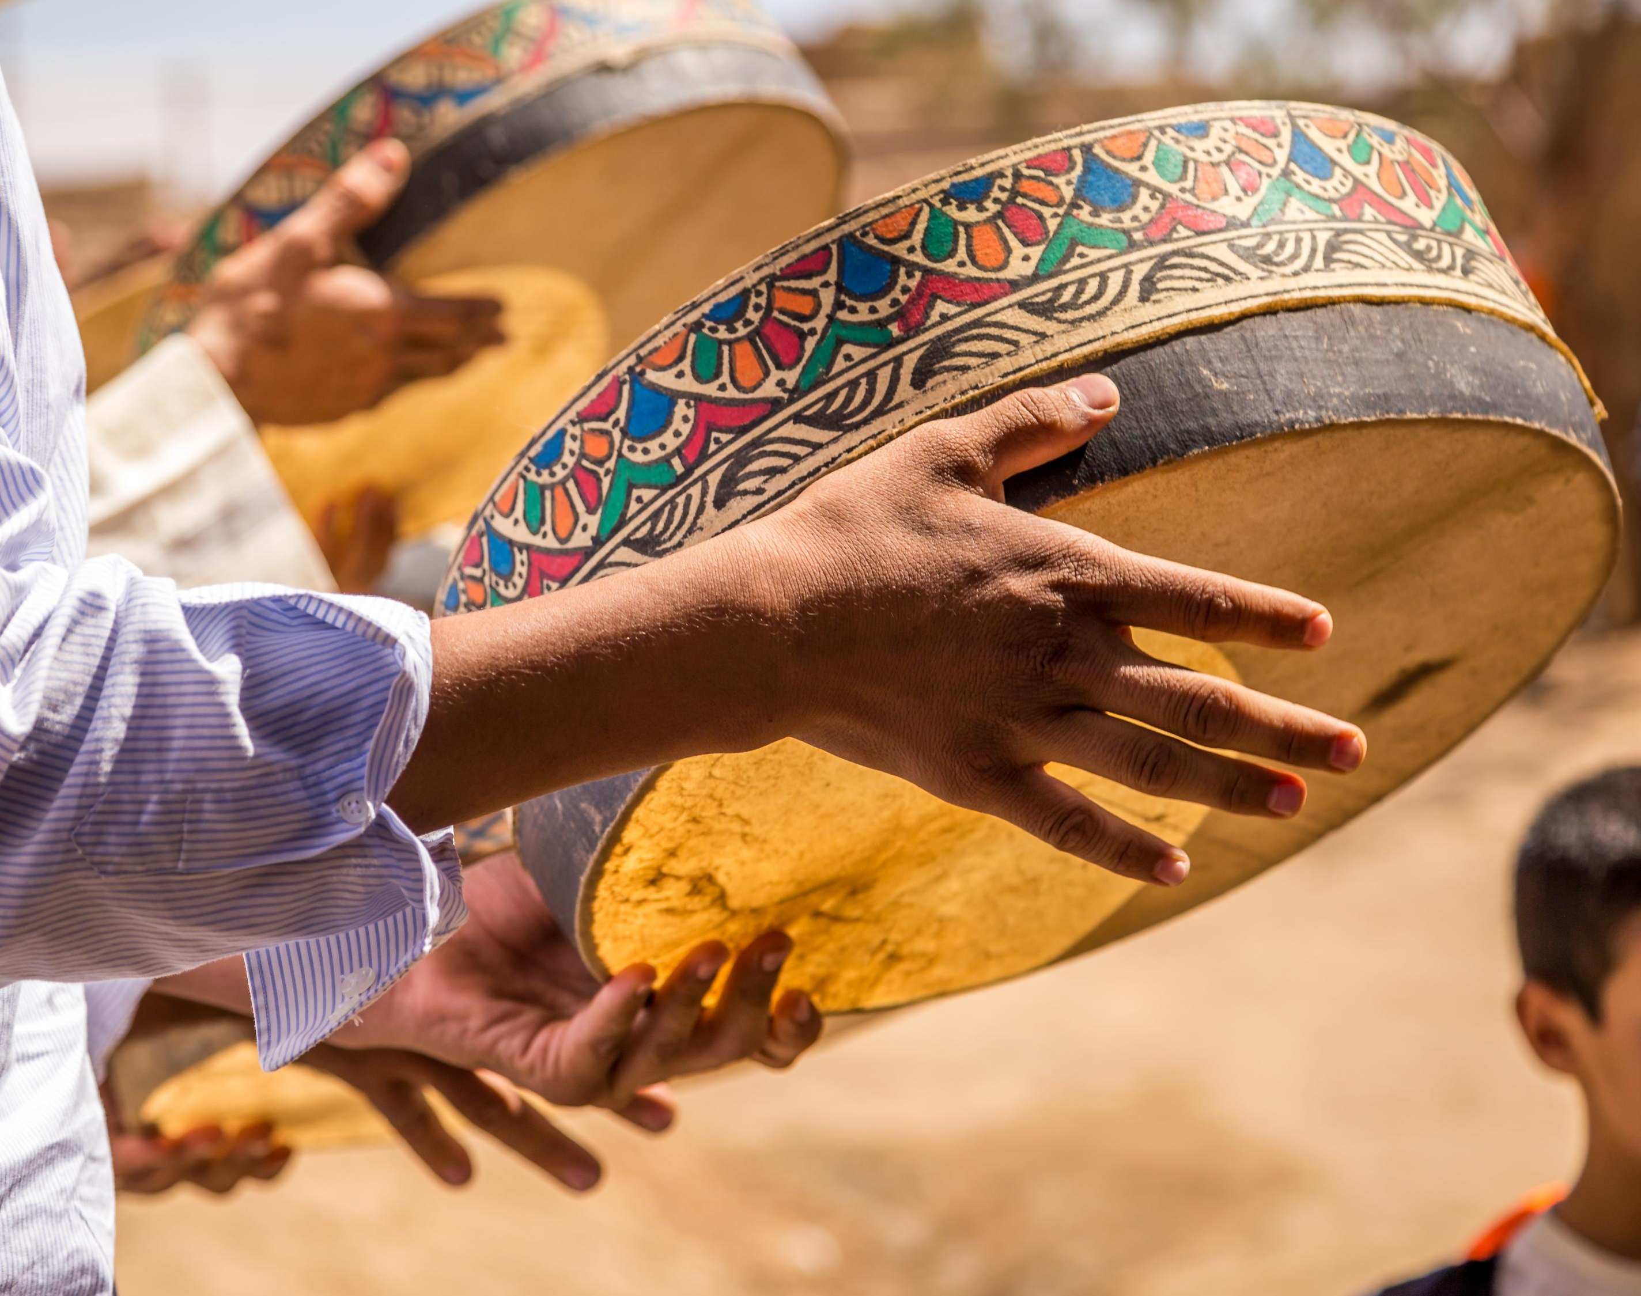
The folk songs of Fiji and the richness of the Indo Fijian Society since the First Girmityas landed in Fiji

Slide 2
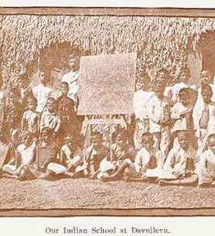

The folk songs culture religious bhajans, ramayan recitals, trikutu, faag, alaaha, birhra, sohar, log geet, bedesia, chautals and nangarra dance of Fiji
Kamini Kumar Brisbane Queensland Australia

Slide 3

Origins of songs
Uttar Pardesh, Bihar and Madhya Pardesh and
Later Andra Pardesh and Madras and other part of South India
The folk songs for the purpose of this presentation is divided into few sections
Religious and linked to Hinduism
Ramayan recitals
Bhajans sung after funeral as per 13day rituals
Kirtans

Slide 4
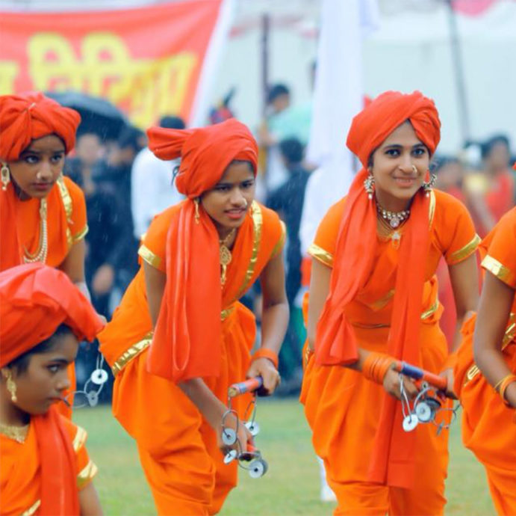
The types of songs
Log Geet –wedding songs
Tassa Drumming and Nangarra Dance
Sohar – after birth of a child
Dance and Religious drama -Trikuti
Ram Leela/Krishna Leela
Qawali by both Hindus and Muslim community

Slide 5
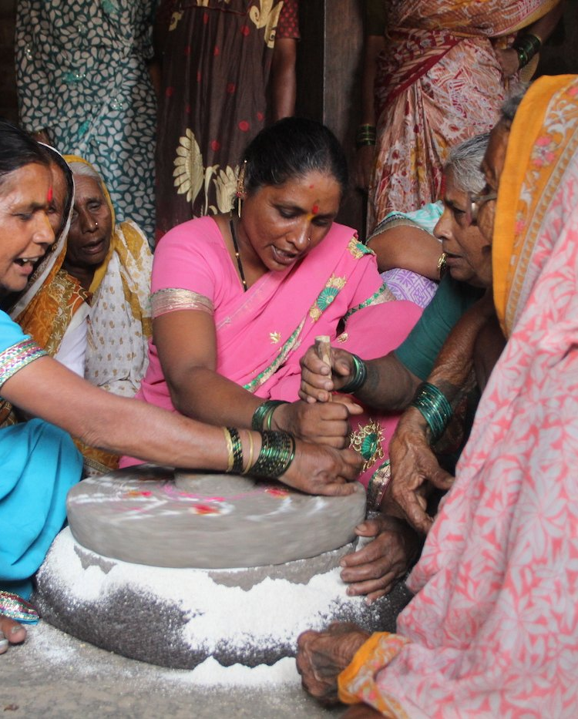
Challenges
Songs and knowledge retained in their memories.
Sung in privacy of their homes or secretly on the farm in the absence of the overseer.
Consequences such as losing a day's wages or being whipped in the morning.
This Photo by Unknown Author is licensed under CC BY-NC-ND

Slide 6
Challenges Contd
Hid the Ramayan in the thatched roof.
Hawan, Ramayan recitals, Rot Katha. Indra Puja was performed in secrecy.
The Girmitya women sang sohar, log geet, chautal, faag, kirtan also with the men

Slide 7

The Awakening
Hinduism and Folk Songs History and Gaining momentum after 1910
The arrival of Lawyer Mani Lal lawyer and Swami Vassist Muni with Pundit Tota Ram Sandhya
Teaching about Faag/Chautals to an area more than 50% of Viti Levu.
Mani Lal & wife and Sadhu Vasist Muni deported in1920s. deported to India

Slide 8
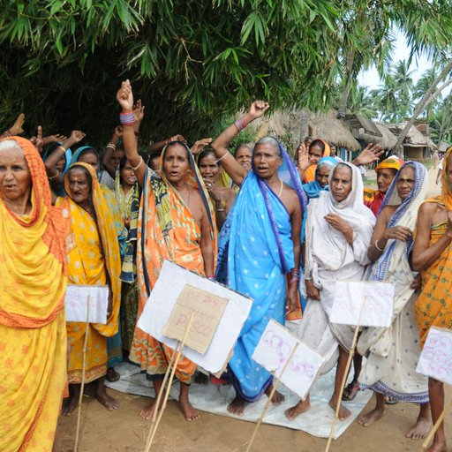
Womens Movement
Uniting women in the Navua, Nausori and Suva areas led to women being engaged to keep the richness of Folk songs alive.
From 1879 when the Girmityas landed foot on Yanuca Lai Lai, Holi was a very important festival for Hindus
This Photo by Unknown Author is licensed under CC BY-NC-ND

Slide 9

Holi Arrives in Fiji
Celebrating Holi and singing Faag/Chautals till the early morning.
Finding solace in Holi.
The faag/chautals took stronghold within the Indian community from 1920 to 1970.
Youngsters singing in Australia, NZ, USA, Canada and revival in Fiji
Faag/Chautal database creation with Radio Manukau Indian FM New Zealand in Hindi and English Versions
The Faag or Chautals sang on Taveuni Island are still the ones that the Girmityas came on the Island in 1879.

Slide 10
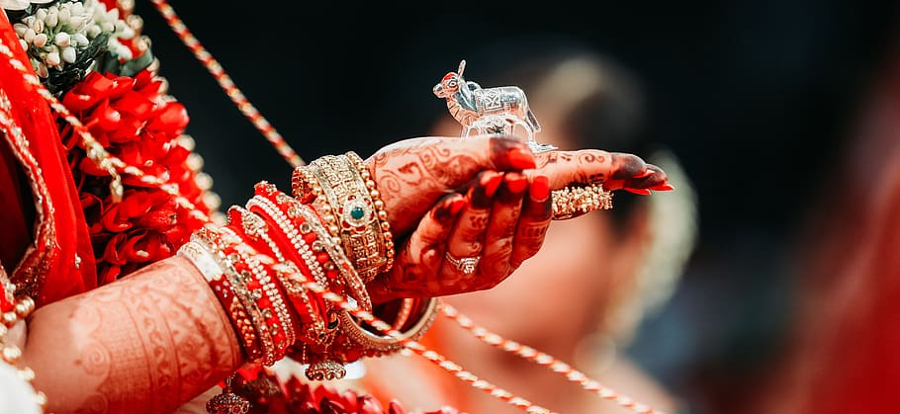
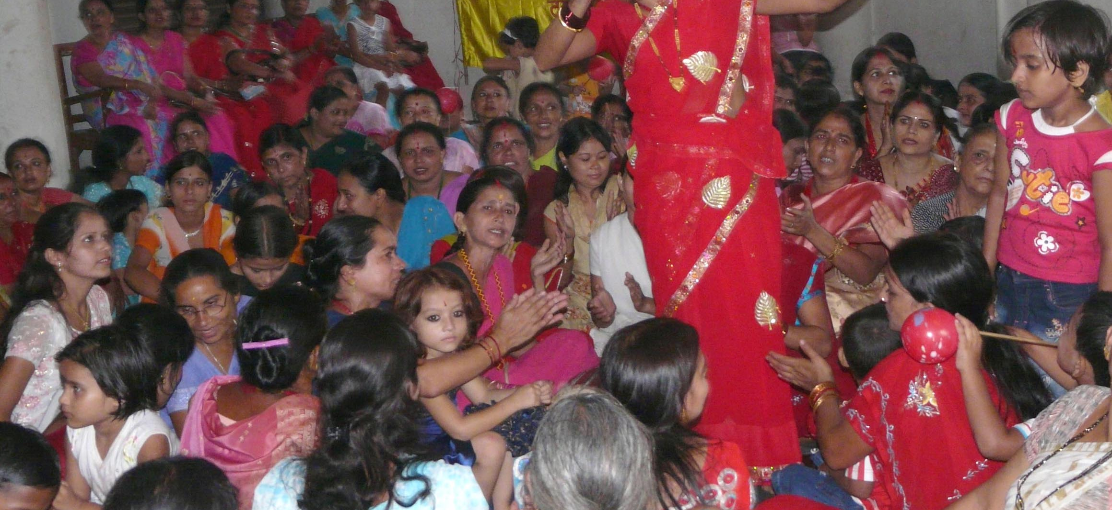
Log Geet, Nagarra Dance and Tassa Drumming
Log geet, Nangarra and Tassa was a common scene.
Log geet - sung on pre wedding days and on the wedding day.
Tassa drumming processions.
Log Geet remains in Indian Diaspora in Fiji.
This Photo by Unknown Author is licensed under CC BY-SA-NC

Slide 11
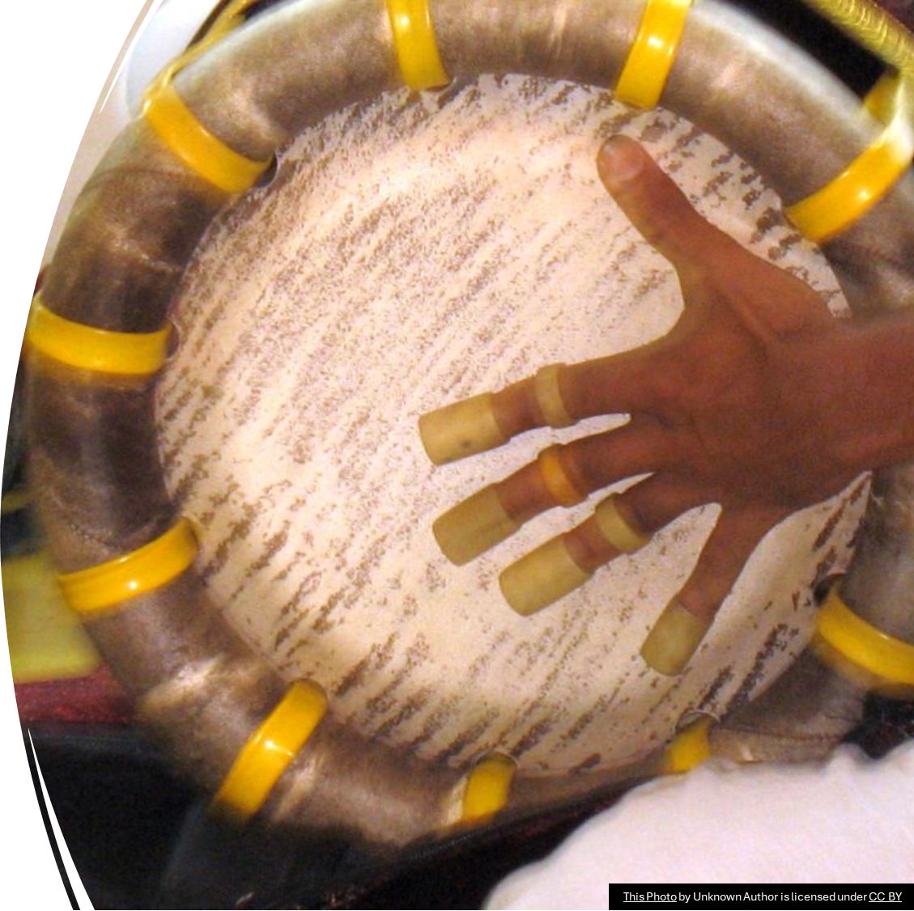
Taasa Drumming
Tassa took a much stronger hold in Vanua Levu and though it was common on Viti Levu it died after 1970 till about 10 years ago.
Tassa drumming has also been taken up by Fiji Indians in New Zealand, Australia, USA, Canada and other countries.
Professionalism in Tassa drumming is happening by accessing you tube videos of Tassa groups from Suriname, Guyana and Trinidad and Tabago.
Nangarra dance and Taasa Drumming

Slide 12
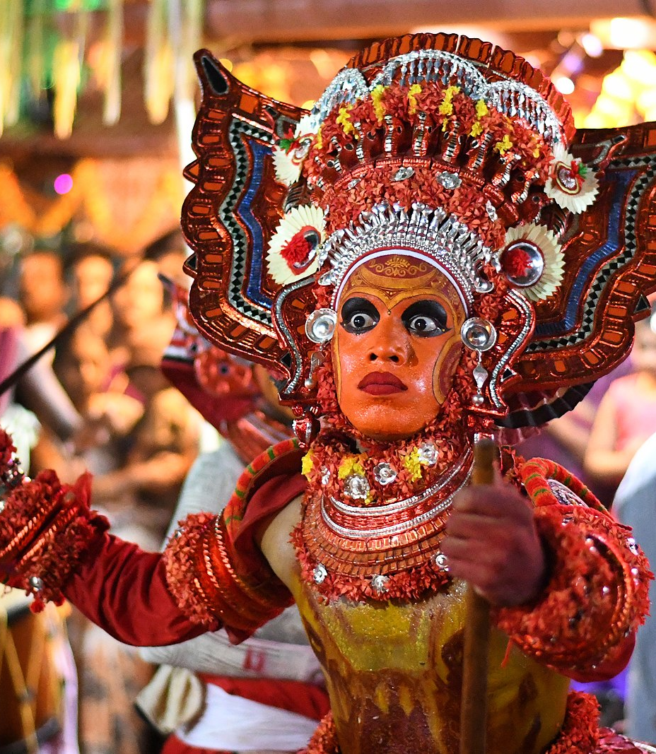
Trikuttu
Tirkutu depicts Epics of Mahabharata Drama and Daphla Drumming through dance, drama and costume
Tirkutu dance and Fire walking ceremony.
Daphla drumming during and before firewalking ceremonies.
Daphla drumming also occurred during weddings and on occasions at funerals of people of South Indian origin.
This Photo by Unknown Author is licensed under CC BY-SA

Slide 13
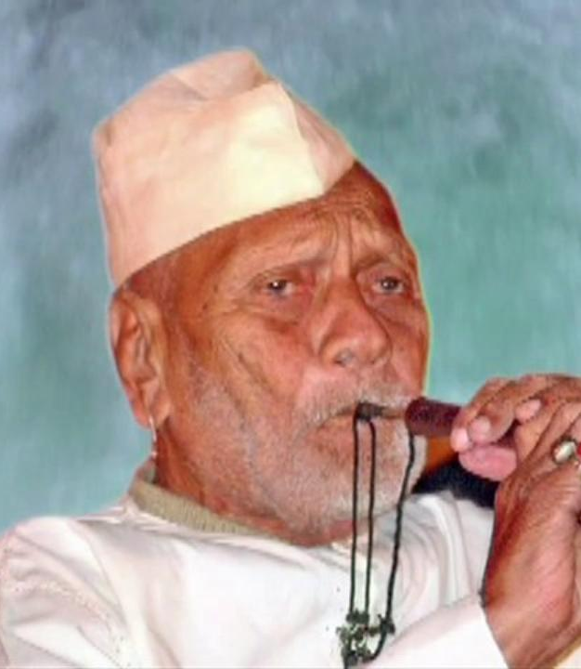
Shahnai
Shennai and Trumpet Music by the South Indian Community
The South Indian Community took an active role in shennai and trumpet playing during weddings, religious ceremonies at weddings, birthday parties, firewalking ceremonies, taiposum pooja, taking hot gulgula from boiling hot oil ceremonies and Matha Durga and Kali prayer ceremonies
Shennai and Trumpet playing has regained momentum in Fiji, Austrlalia, New Zealand, USA and Canada.
This Photo by Unknown Author is licensed under CC BY-NC-ND

Slide 14
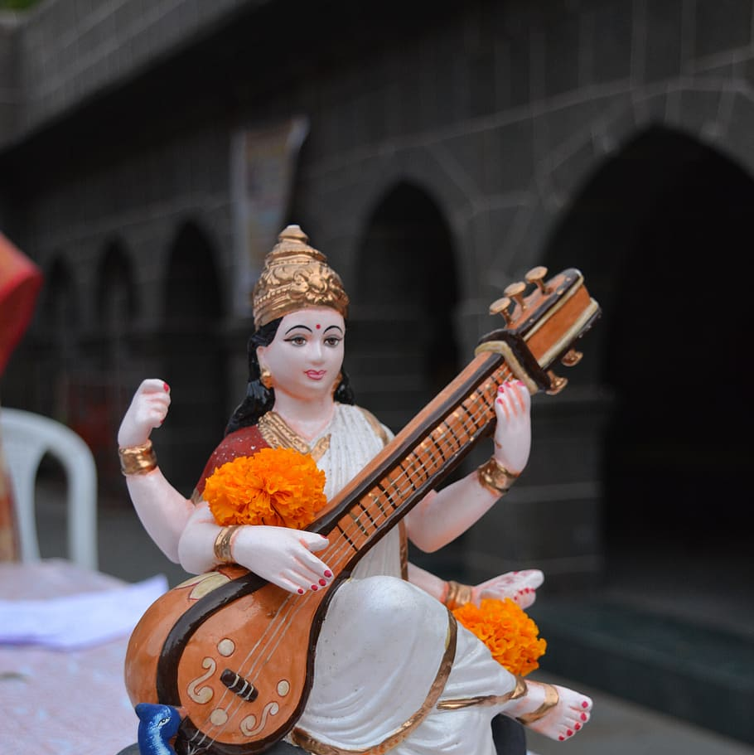
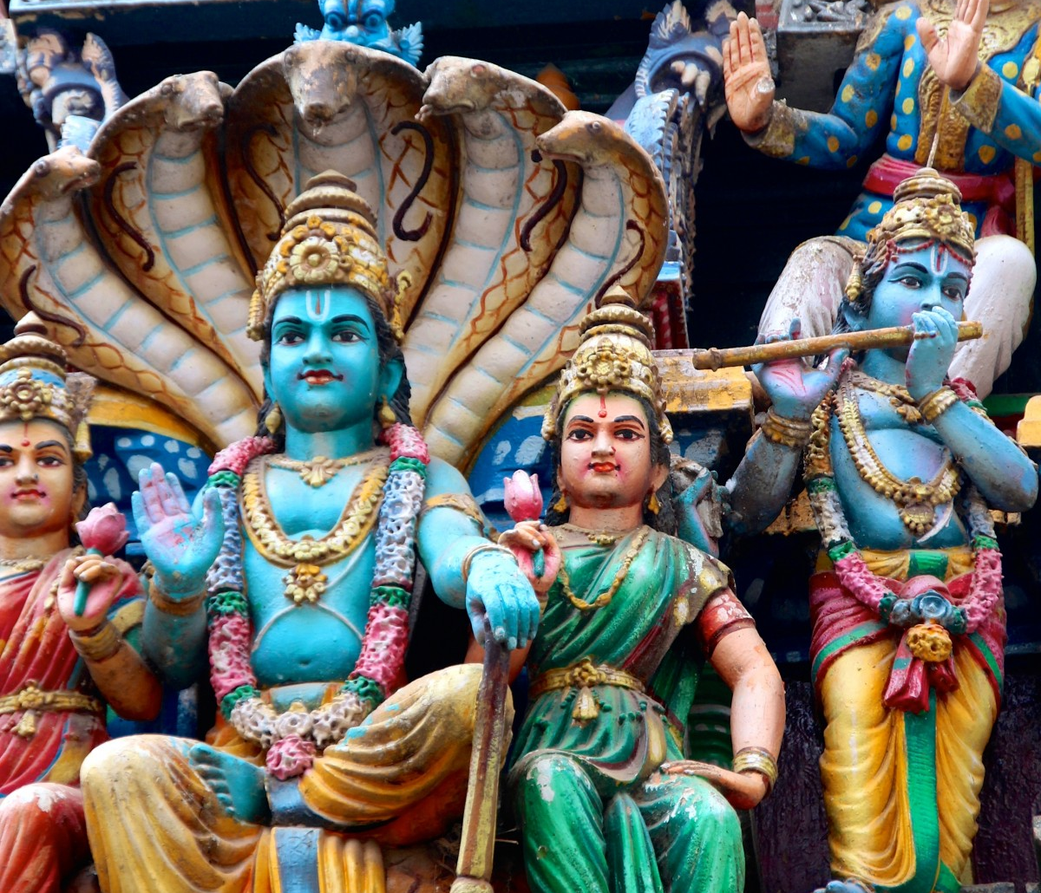
Bhajans and Kirtans
Bhajans and kirtans were sung by Girmityas when they first arrived in Fiji.
Bhajans were sung mostly during the 13 days of mourning periods.
Bhajans were either sung by individual singers by forming their own groups or in mandalis.
Bhajan nights were organised to raise funds for schools.

Slide 15
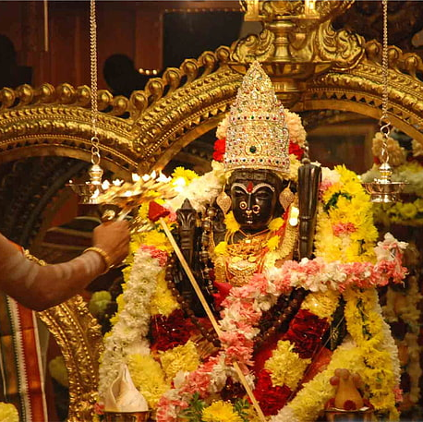
Kirtans
Sung:
during and after religious ceremonies,
during mourning periods after funerals
by individuals
in a group or
in mandalis and sung by Fiji Indians in all the countries settled upon migration

Slide 16
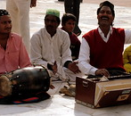
Qawali
Qawalis were sung by Girmityas upon arrival in 1879.
Still sung by both Hindus and Muslim community.
The singing of Qawalis has declined over the years.
This Photo by Unknown Author is licensed under CC BY

Slide 17
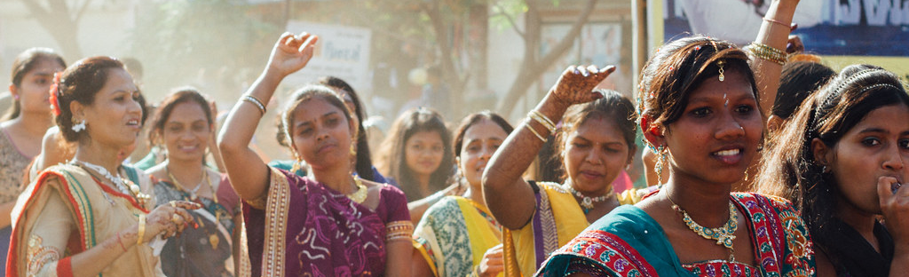
Women and Dancing
Log Geet, Sohar and Dancing amongst women in Fiji
Till early 1970s women danced during rituals of births, marriages and other occasions.
These were sung either by individual women or Mahhila Mandals (women groups) or mandalis.
These were sung by elderly ladies including young married ladies and young girls.
Dancing was very common from 1880 till early 1970s when women and girls danced all nights or few hours during the days of the wedding.
The dancing of women and girls declined after mid 1970s due to the stigma.
This Photo by Unknown Author is licensed under CC BY-NC-ND

Slide 18
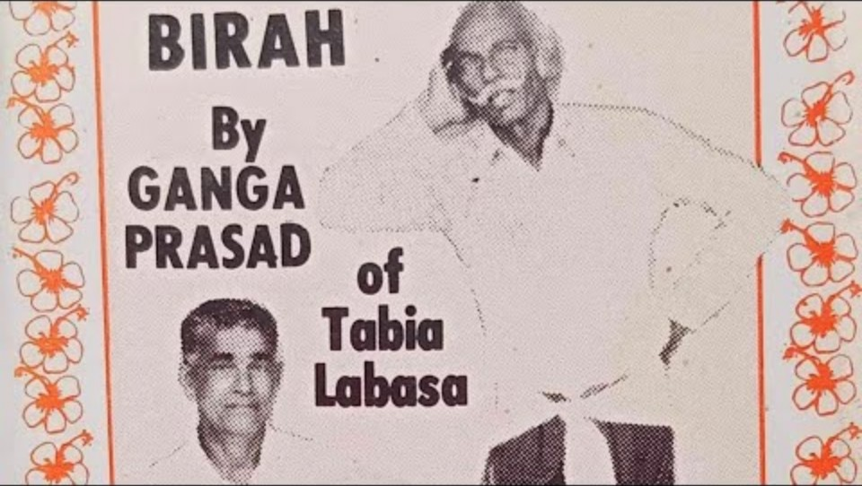
Bihra and Aahlaa
Bihra and Aalhaa were sung by Girmitya men mostly self composed and reflected the pain, suffering and anguish of working on plantations and farms and the sheer poverty
Bihra and Aahlaa were sung in pockets in Fiji usually by groups of men in a mandali or in informal groups or impromptu sessions.
These declined in Viti Levu however remained prominent in Vanua Levu. It has declined quite significantly in Fiji and cannot predict whether the younger generation will commence practising this in the future

Slide 19
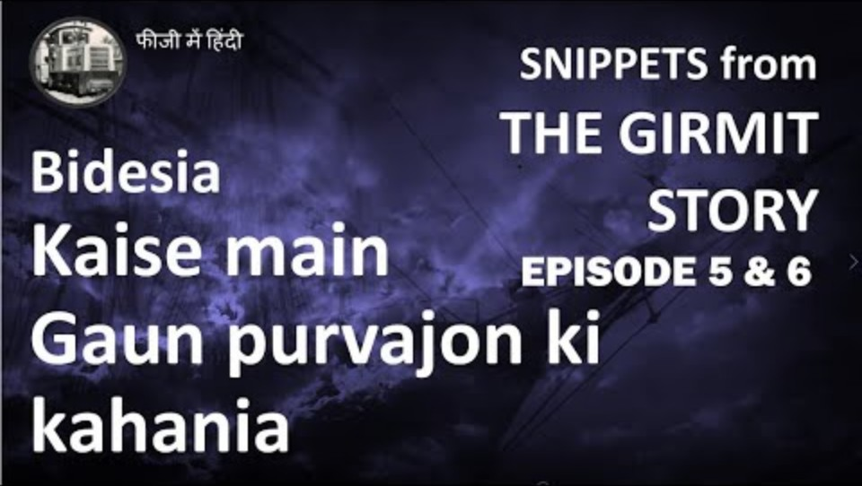
Bidesia Singing
Bedesia singing was done by early Girmitya women.
These songs depicted the hardships of working on farms.
These were very powerful messages, but they were able to synchronise with romance.

Slide 20
Bidesia Contd
Bedesia singing is nearly extinct in Fiji.
The roots of Bedesia originated in Eastern Uttar Pardesh and Bihar and taken to various countries by Girmityas

Slide 21
The folk songs of Fiji
Folk songs, unity and the respect of family and togetherness as a community
The folk songs united the Girmityas and Indian community together
This further assisted them to build schools for their children
Assisted them to build temples and mosques in Fiji
Assisted them to retain the language Hindi, Urdu, Tamil, Telugu and Madaillam
Ram Lila and Krishan Lila were celebrated then and still now
The folk songs played a vital role to keep the Girmityas in the right mental frame of mind

Slide 22
Conclusion
The Richness of folk songs assisted in the formation and maintenance of a respectable community and society.
The colonial masters were surprised and a shock to the system when the first Indian primary school commenced in Wairoku RakiRaki
The Girmityas with their culture, folk songs were able to forge a community that did not interfere with the I Taukei culture
The richness of the Indian diaspora from Fiji has continued till today and has made them a very respectable community in all the countries settled by us

Slide 23
Homage to The Girmitiyas
Many say that the Girmityas created another India in the South Pacific so many thousand kilometres from Uttar Pardesh and Birha but many do not know the reasons for this.
It was sheer survival and the will to survive and to break the shackles of indenture and poverty.

